Slide 1
Learning Disability Detector
Submitted in the partial fulfillment for the award of the degree of
BACHELOR OF ENGINEERING
IN
BIG DATA ENGINEERING
Submitted by:
Anchal-21BCS4703
Omkar Hiremath-21BCS6789
Under the Supervision of:
Dr. Monica Luthra
Department of AIT-CSE
DISCOVER . LEARN . EMPOWER

Slide 2
Outline
Introduction to Project
Problem Formulation
Objectives of the work
Methodology used
Results and Outputs
Conclusion
Future Scope
References

Slide 3

Introduction to Learning Disabilities
Learning disabilities are neurological conditions that affect an individual's ability to process and understand information.
They can impact various cognitive skills, such as reading, writing, math, or focus, and often manifest early in a person's academic journey.

Slide 4

Symptoms and Signs of Learning Disabilities
Difficulty with reading, writing, or math skills despite average or above-average intelligence
Struggles with organization, planning, and time management that interfere with daily activities
Problems with attention, memory, or processing speed

Slide 5

Diagnosing Learning Disabilities
Comprehensive Evaluation
Identifying Strengths and Weaknesses
A thorough assessment by qualified professionals, including educational, psychological, and medical evaluations, is crucial for accurately diagnosing learning disabilities.
Evaluations aim to pinpoint an individual's specific strengths and weaknesses to develop targeted interventions and support strategies.
Multidisciplinary Approach
A team of experts, such as teachers, psychologists, and occupational therapists, collaborates to provide a comprehensive understanding of the learning disability.

Slide 6

Preliminary Design
In the preliminary design phase, we will outline the key components and functionalities of the learning disability detector system.
This includes defining the target audience, identifying the key features and algorithms
Planning the overall architecture and user interface.

Slide 7

Methodology
The project employed a rigorous, data-driven methodology to develop an accurate learning disability detection system.
Machine learning, psychology, and education collaborated to define the optimal analytical approach.
Techniques such as ensemble modeling, feature engineering, and hyperparameter tuning were utilized to maximize the predictive power of the final model.

Slide 8
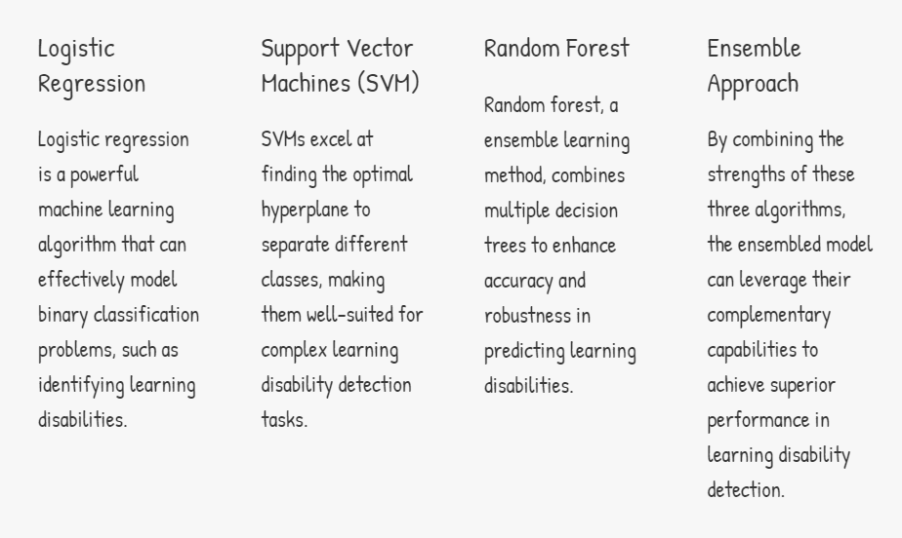
Ensembled model

Slide 9
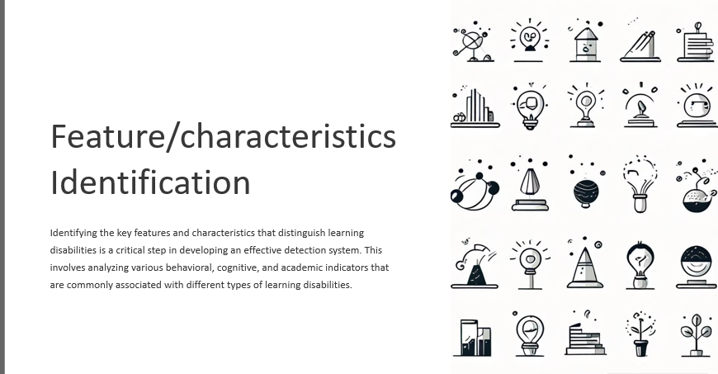

Slide 10
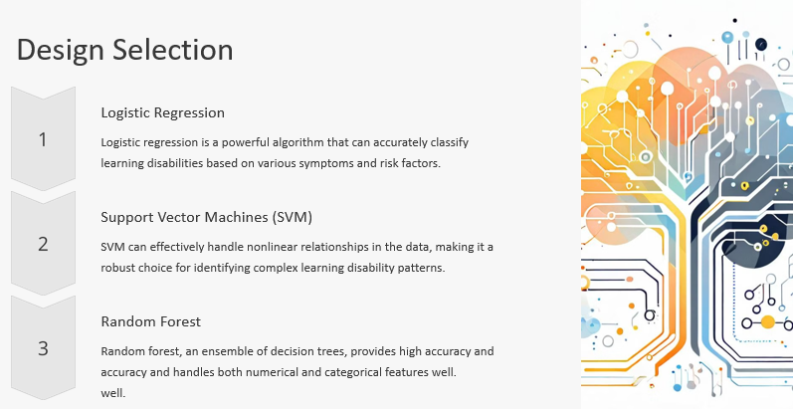

Slide 11
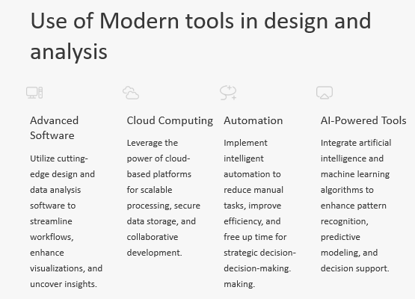

Slide 12
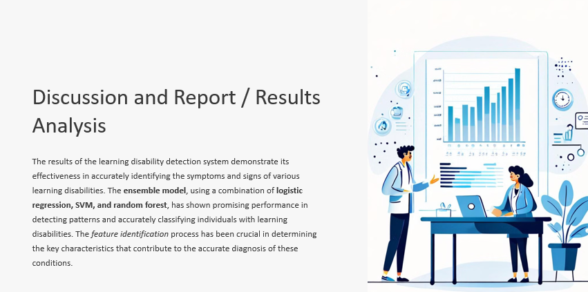

Slide 13
References
1. American Psychiatric Association. (2013). Diagnostic and statistical manual of mental disorders (5th ed.). American Psychiatric Publishing.
2. Alloway, T. P., & Alloway, R. G. (2010). Investigating the predictive roles of working memory and IQ in academic attainment. Journal of Experimental Child Psychology, 106(1), 20-29. [doi:10.1016/j.jecp.2009.11.003]
3. Bakopoulou, I., & Dockrell, J. E. (2016). The role of working memory and language in mathematics achievement in children with and without intellectual disabilities. Journal of Intellectual Disability Research, 60(3), 216-230. [doi:10.1111/jir.12244]
4. Berninger, V. W., Abbott, R. D., Thomson, J. B., Raskind, W., & Richards, T. (2008). Writing and reading: Connections between language by hand and language by eye. Journal of Learning Disabilities, 41(6), 572-590. [doi:10.1177/0022219408326219]
5. Fletcher, J. M., Lyon, G. R., Fuchs, L. S., & Barnes, M. A. (2007). Learning disabilities: From identification to intervention. Guilford Press.
6. Frazier, T. W., Demaree, H. A., & Youngstrom, E. A. (2007). Meta-analysis of intellectual and neuropsychological test performance in attentiondeficit/hyperactivity disorder. Neuropsychology, 21(6), 845-855. [doi:10.1037/0894-4105.21.6.845]
7. Giangreco, M. F., Edelman, S. W., Luiselli, T. E., & MacFarland, S. Z. (2003). Helping or hovering? Effects of instructional assistant proximity on students with disabilities. Exceptional Children, 69(4), 391- 408. [doi:10.1177/001440290306900402]
8. Lerner, J. W. (2012). Learning disabilities and related disorders: Characteristics and teaching strategies. Houghton Mifflin Harcourt.
9. Opitz, D., & Maclin, R. (1999). Popular ensemble methods: An empirical study. Journal of Artificial Intelligence Research, 11, 169-198.
10. Salend, S. J. (2011). Creating inclusive classrooms: Effective and reflective practices. Pearson.

